Slide 1

CANVASS DISCUSSION FORUM
A Web App by Gagandeep Shubham

Slide 2

About
CANVASS is a tool for sharing thoughts and ideas about class materials, and it is made up of forums and threads. It is a method of asynchronous online communication or an electronic message center. Users connect with the center via a modem or other devices, they can read messages posted by others and respond or leave messages on other topics. The CANVASS allows students to post threads (comments or responses) to forums usually created by the instructor. The posted threads (comments, responses) can be viewed and responded to by the instructor and other students enrolled in the course.

Slide 3


1. What is CANVASS ?
Nowadays keeping the record of everything we do is a daunting task.We might not be able to remember everything we do or anything we are supposed to do, all the time,just like the assignments given in colleges. What student does is, they just write their assignments on a plain paper and submits to the instructors, only to regret later at the time of exams,because they can not revise everything in a short span of time.

Slide 4
Let us dive into CANVASS.

Slide 5
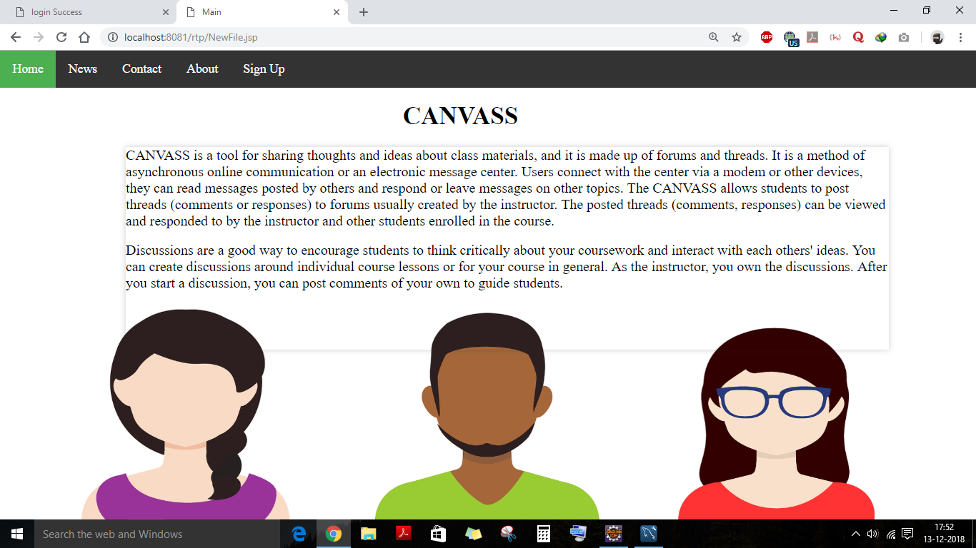

Slide 6
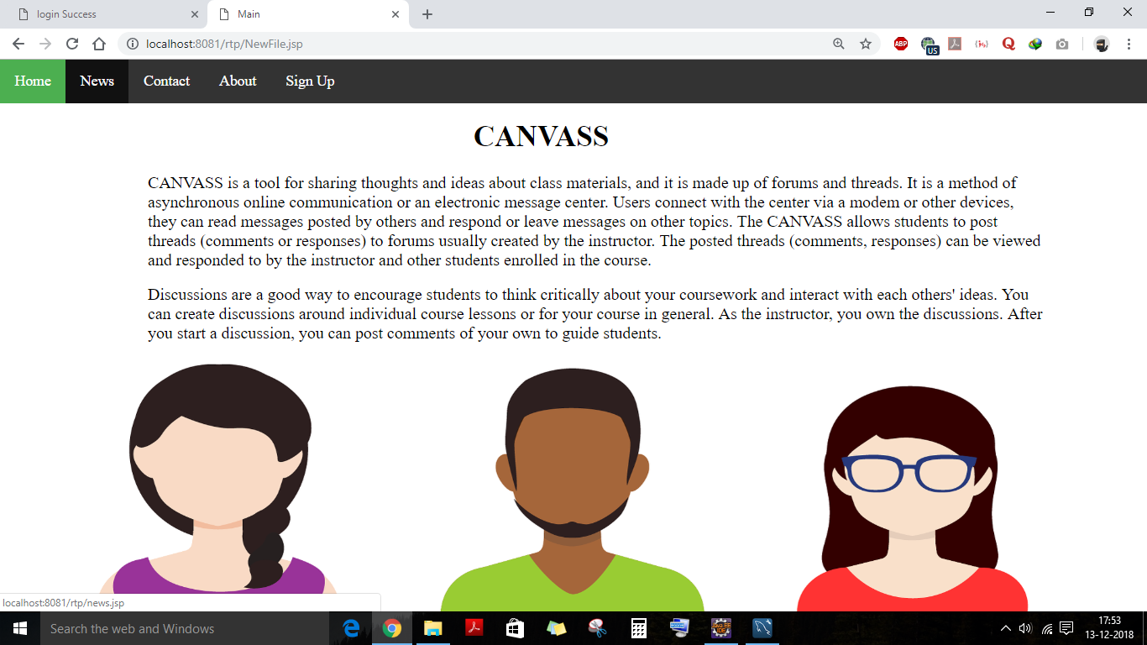

Slide 7
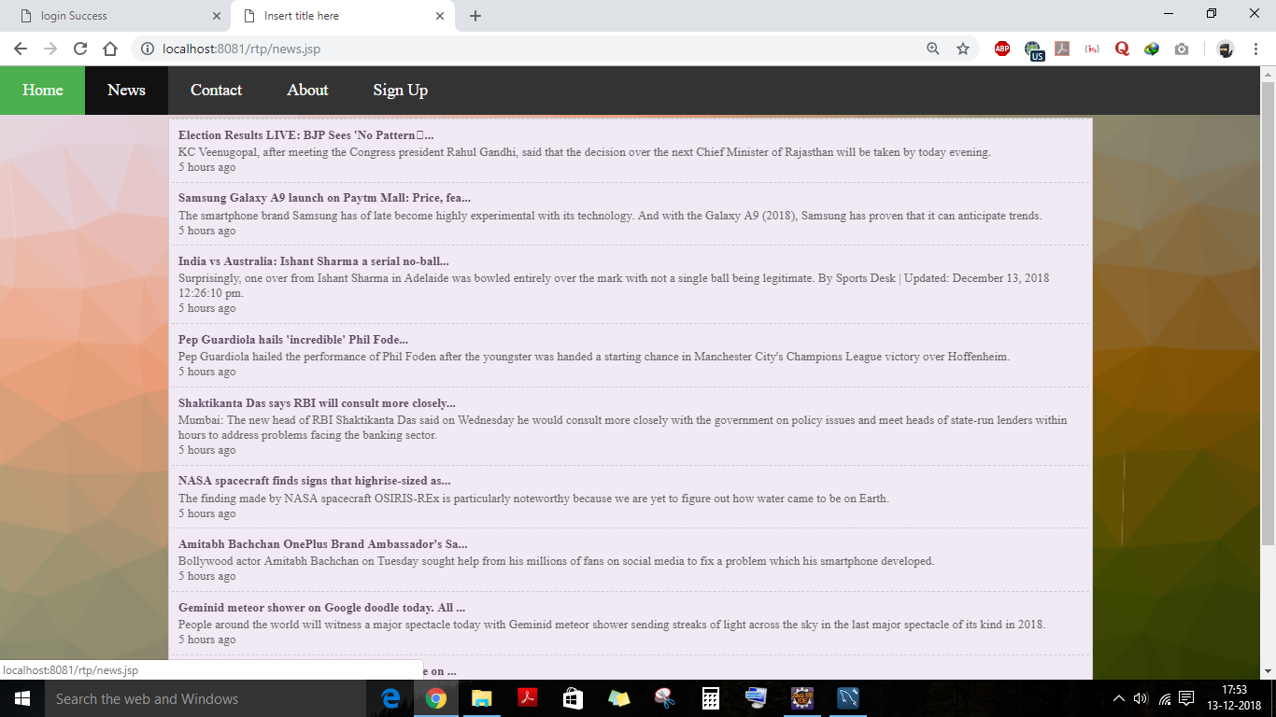

Slide 8


Slide 9
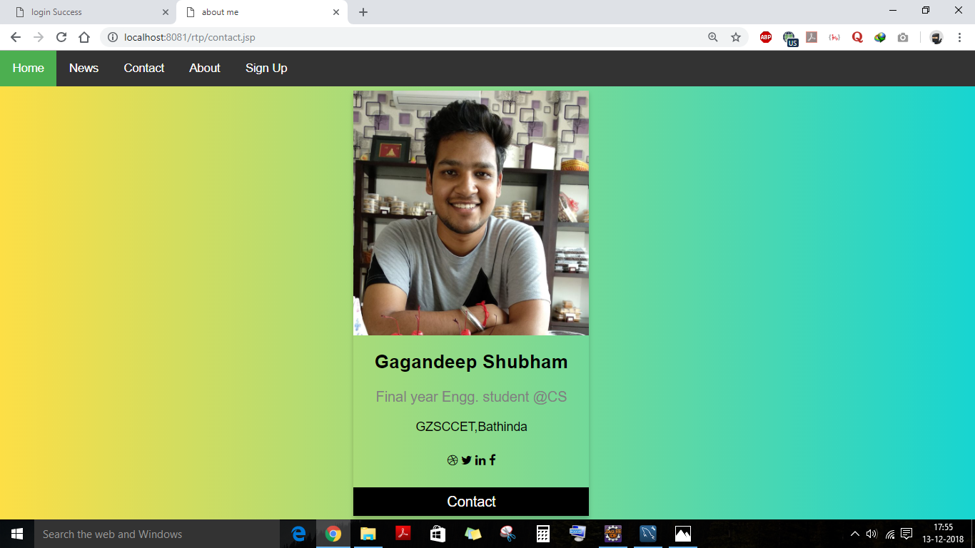

Slide 10
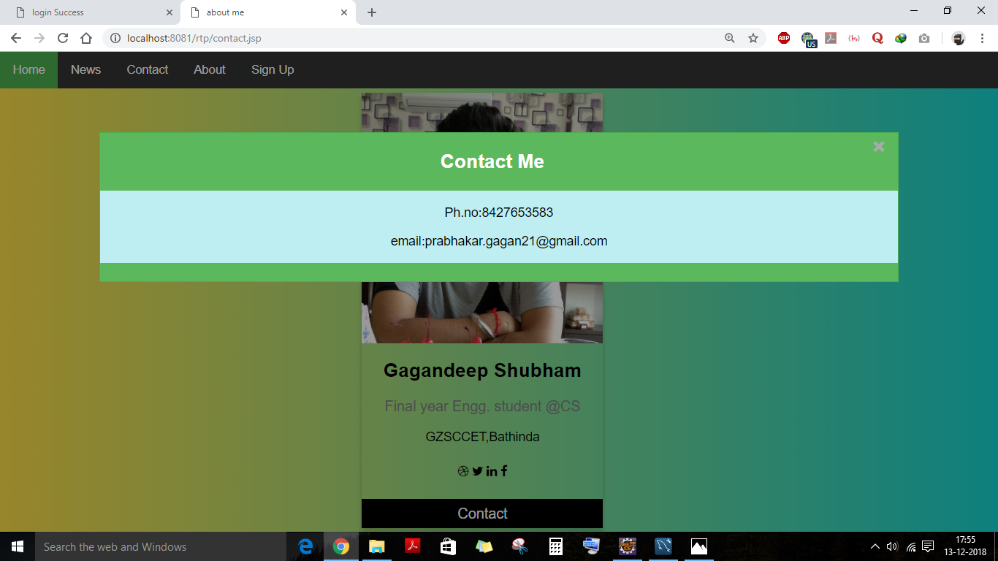
Story for illustration purposes only

Slide 11
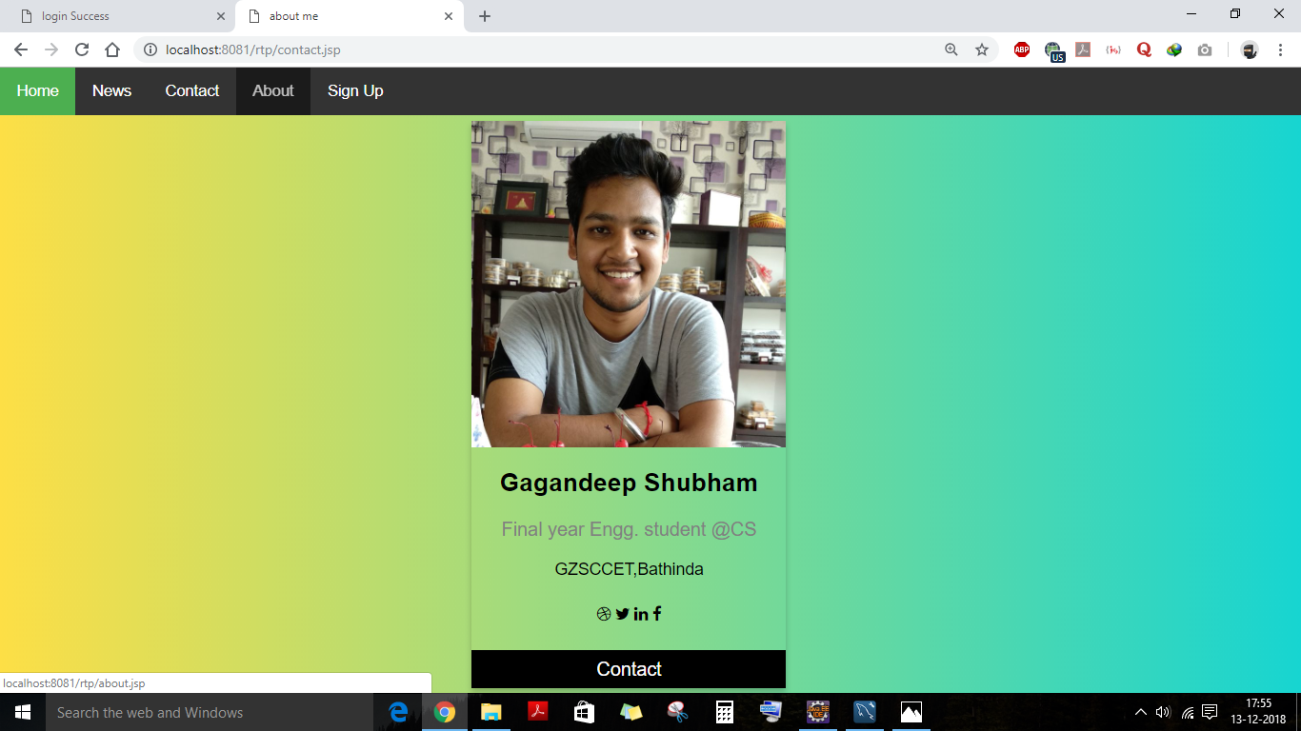

Slide 12
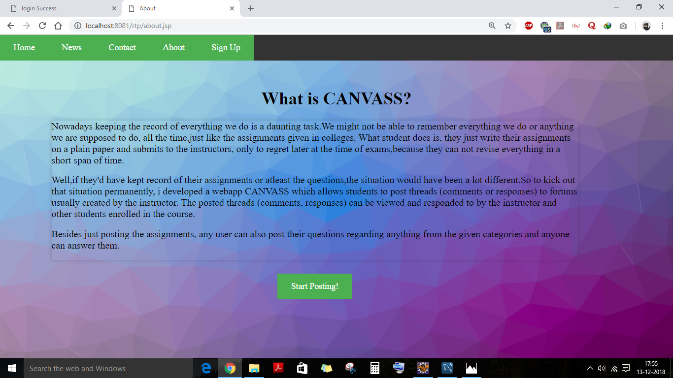

Slide 13
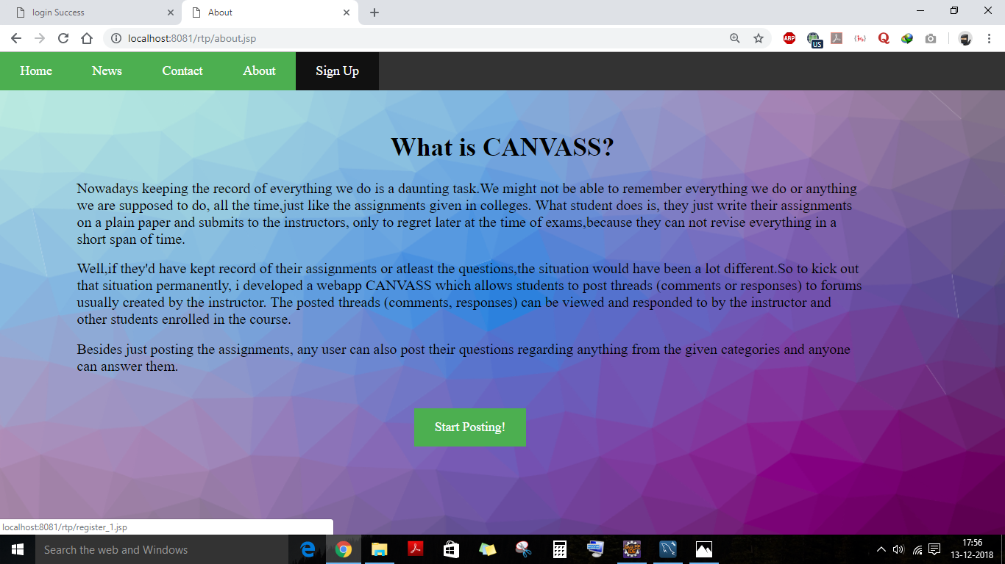

Slide 14
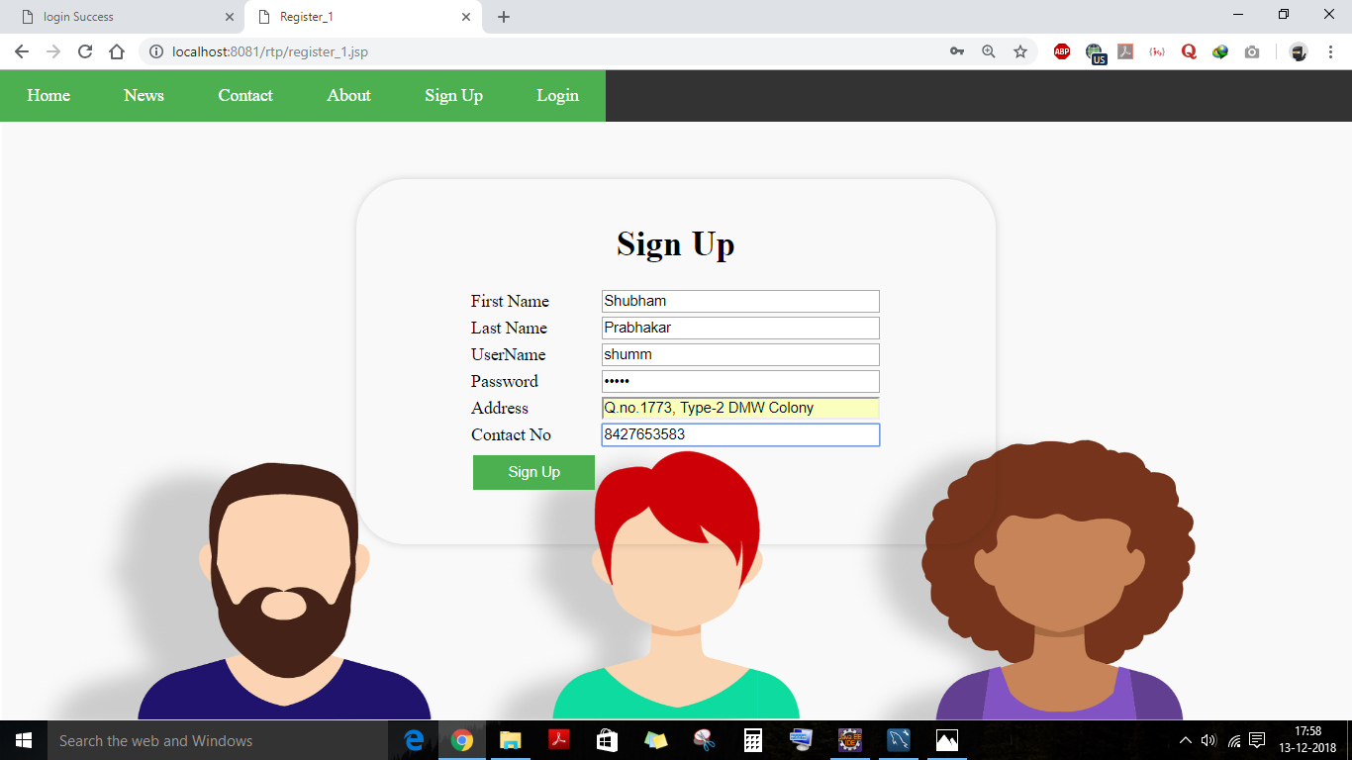

Slide 15
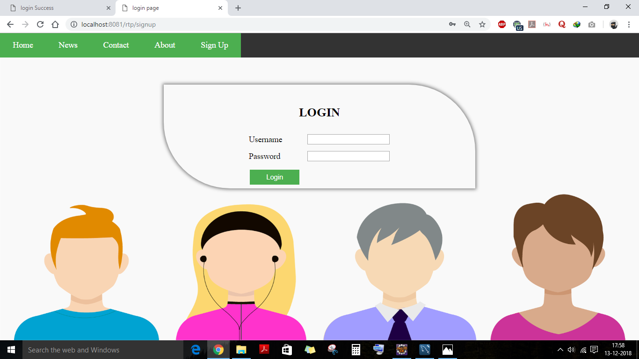

Slide 16
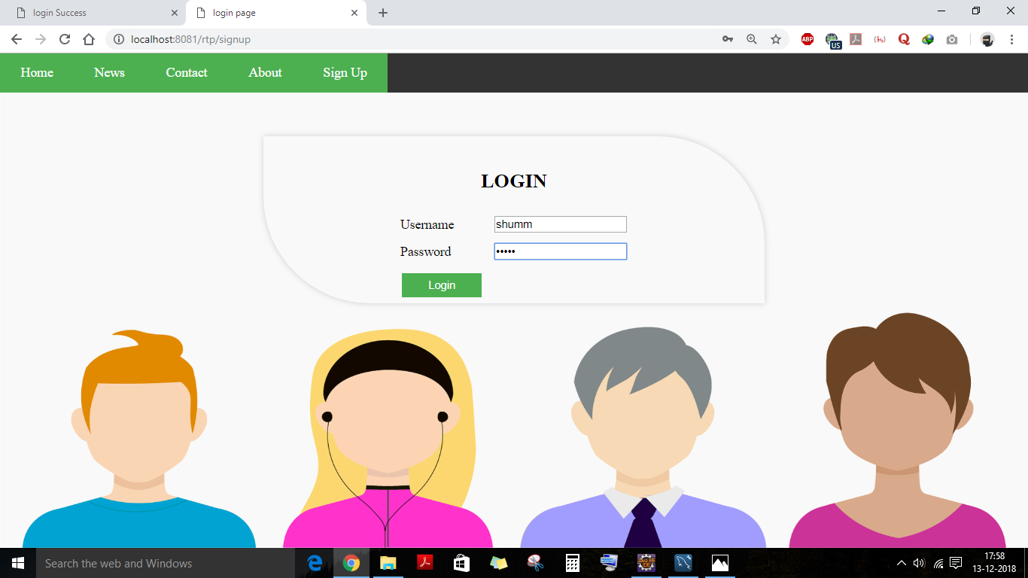

Slide 17
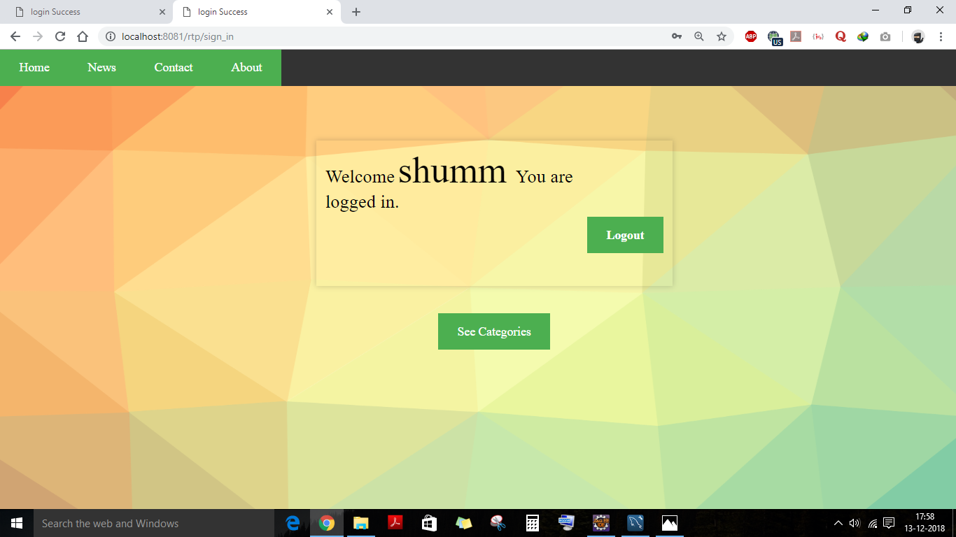

Slide 18
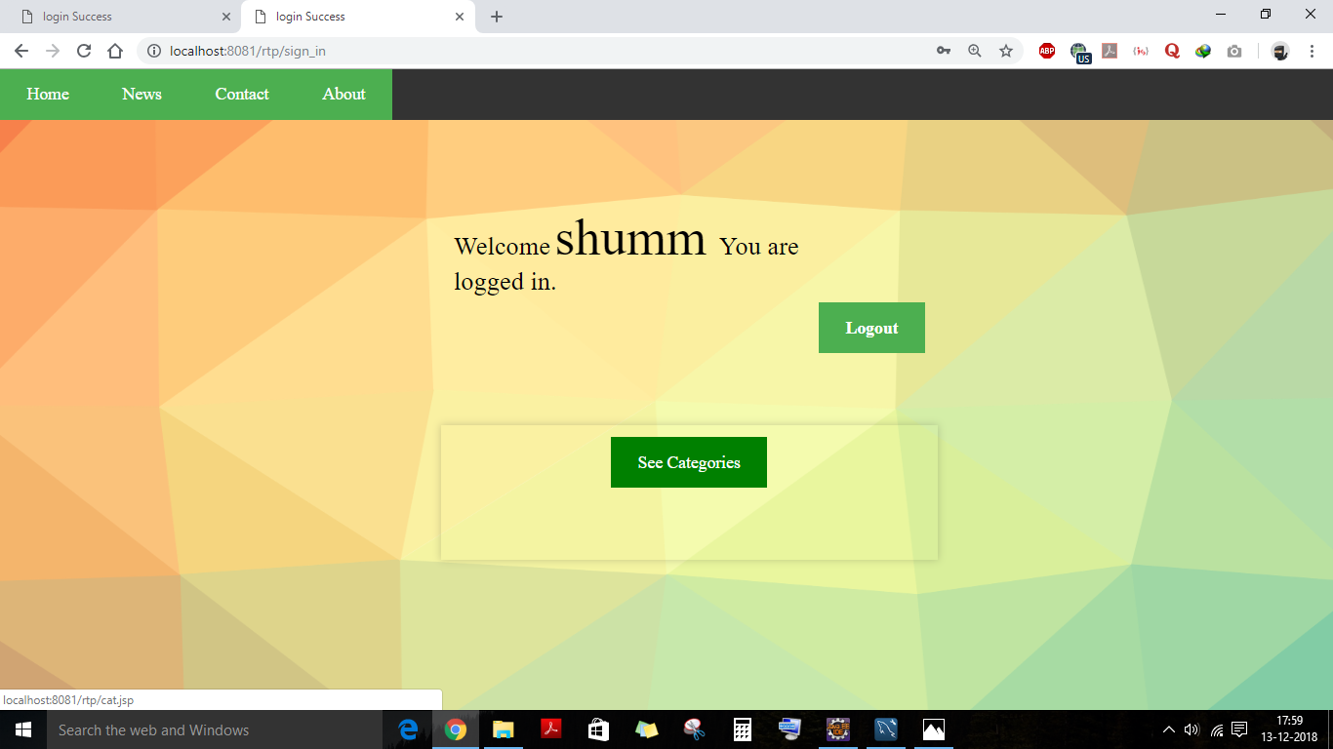

Slide 19
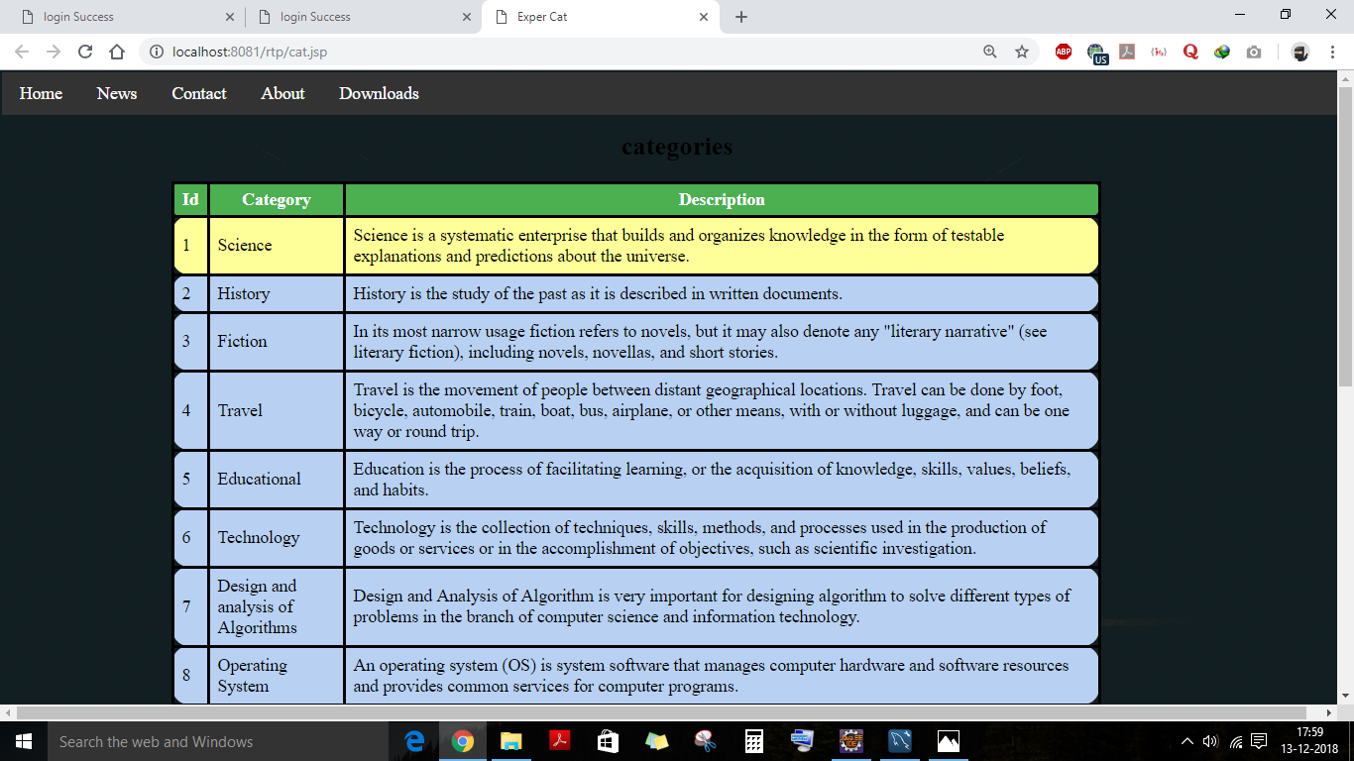

Slide 20
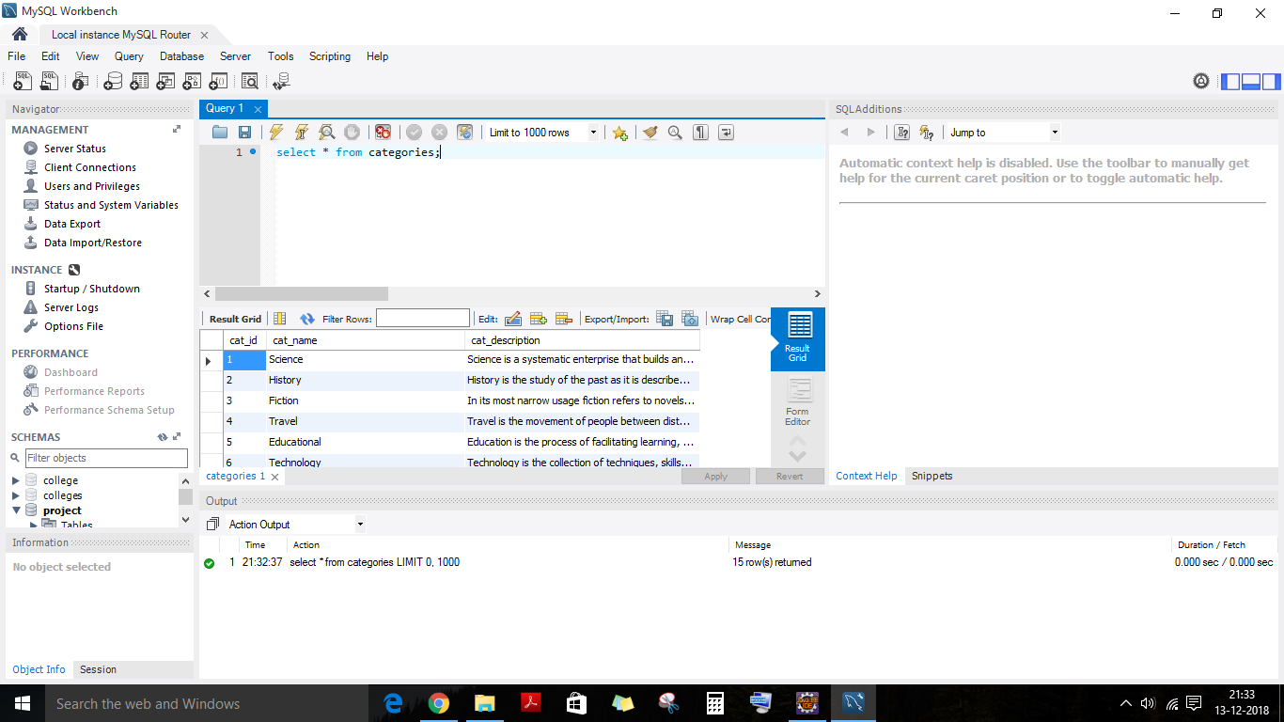

Slide 21
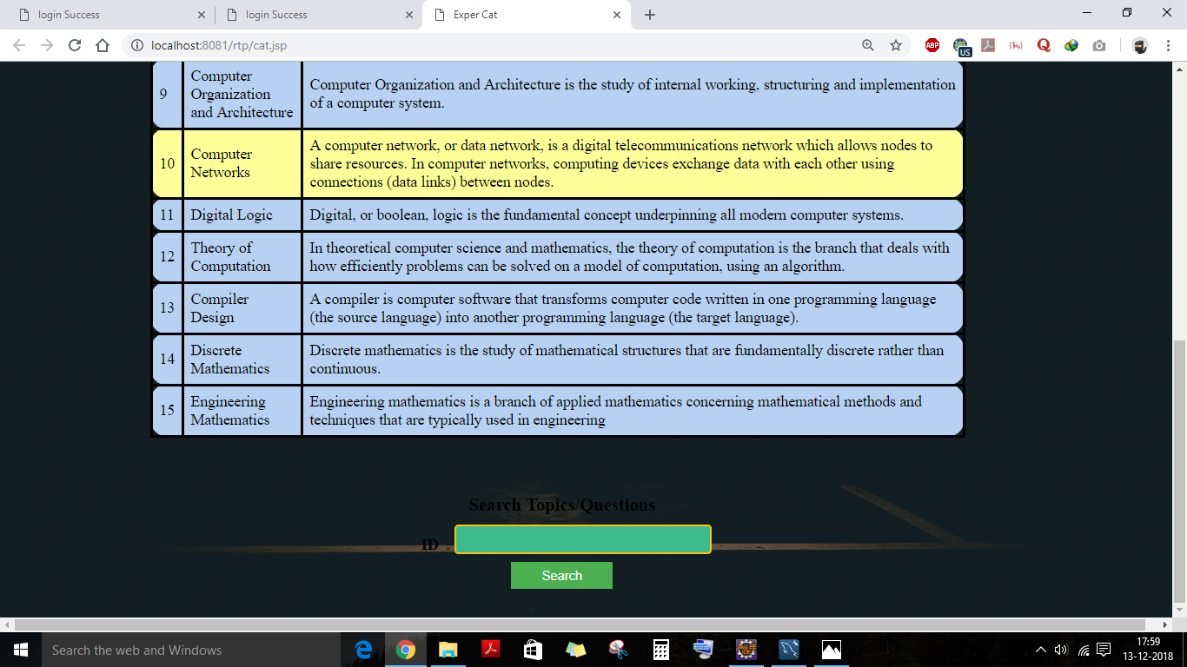

Slide 22
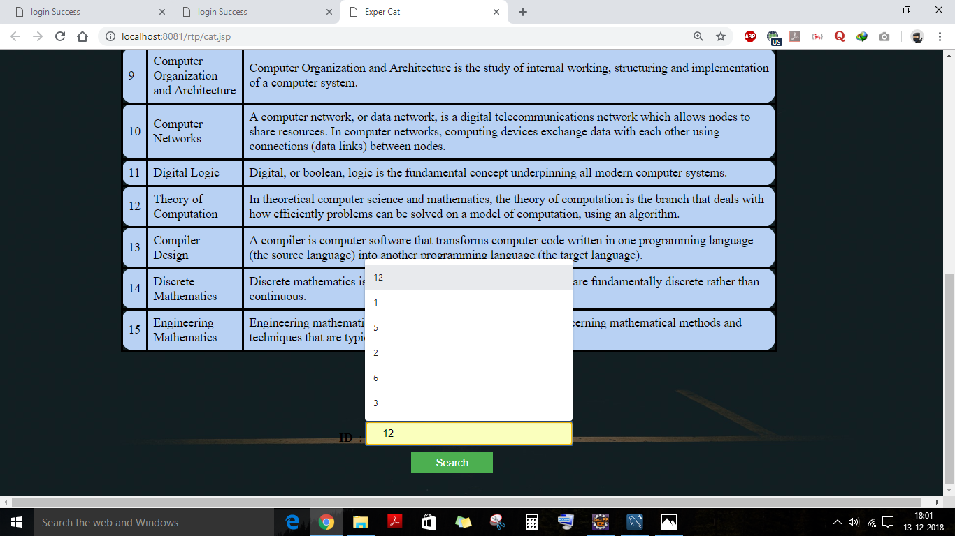

Slide 23
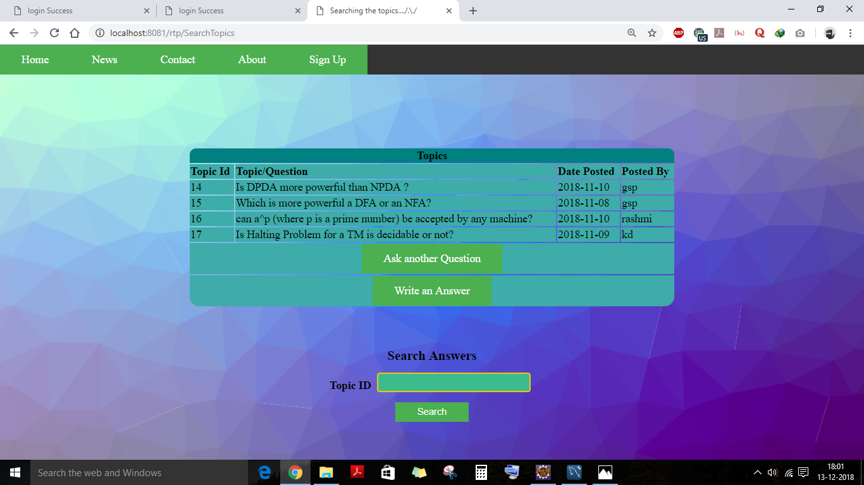

Slide 24
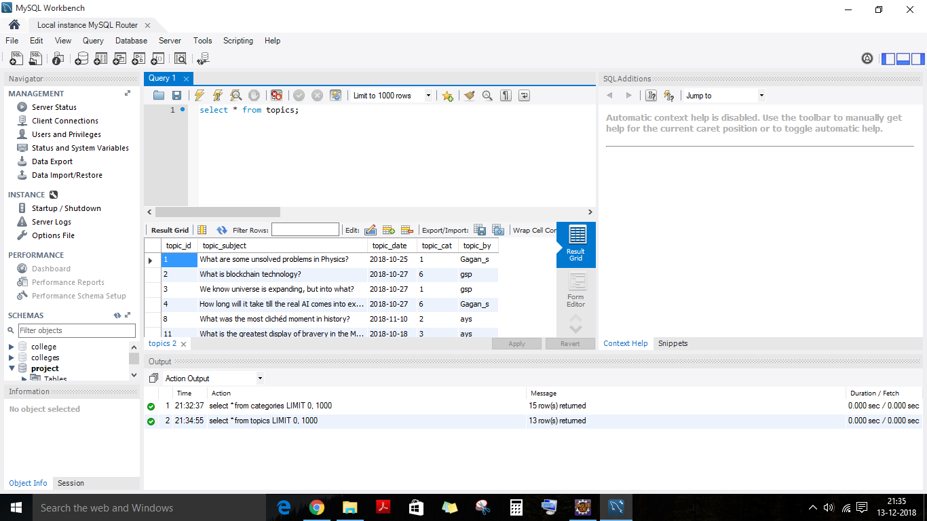

Slide 25
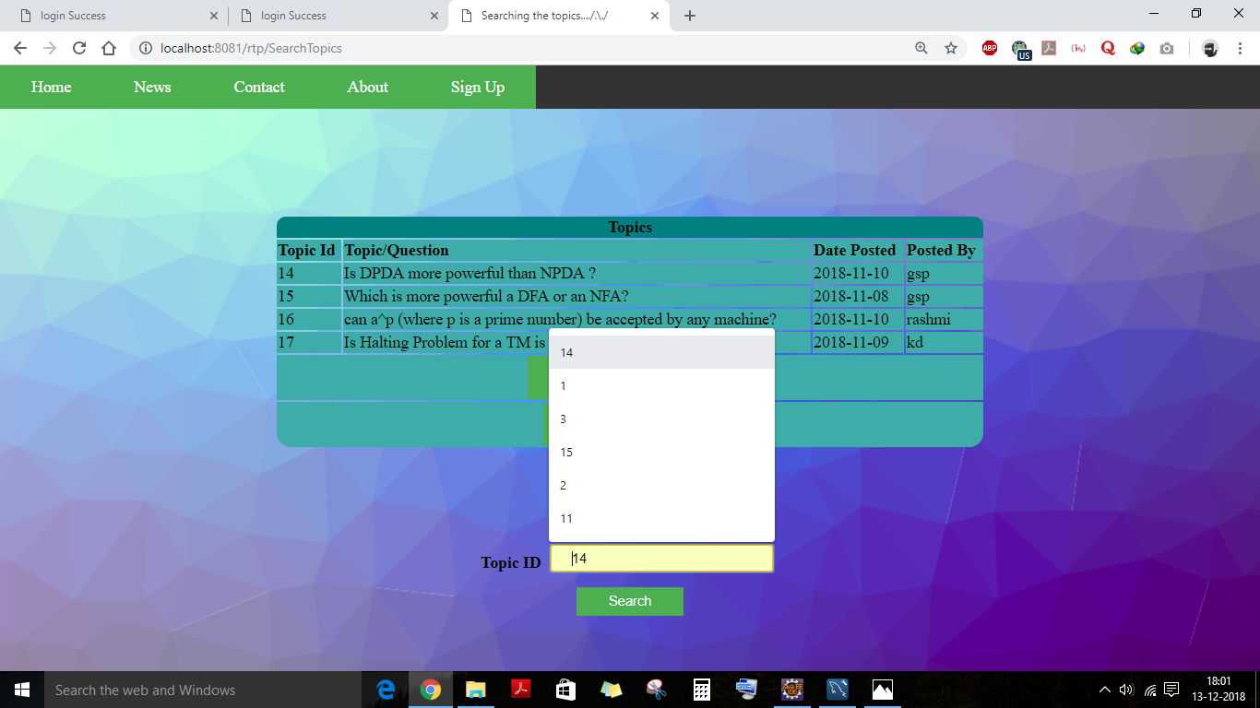

Slide 26
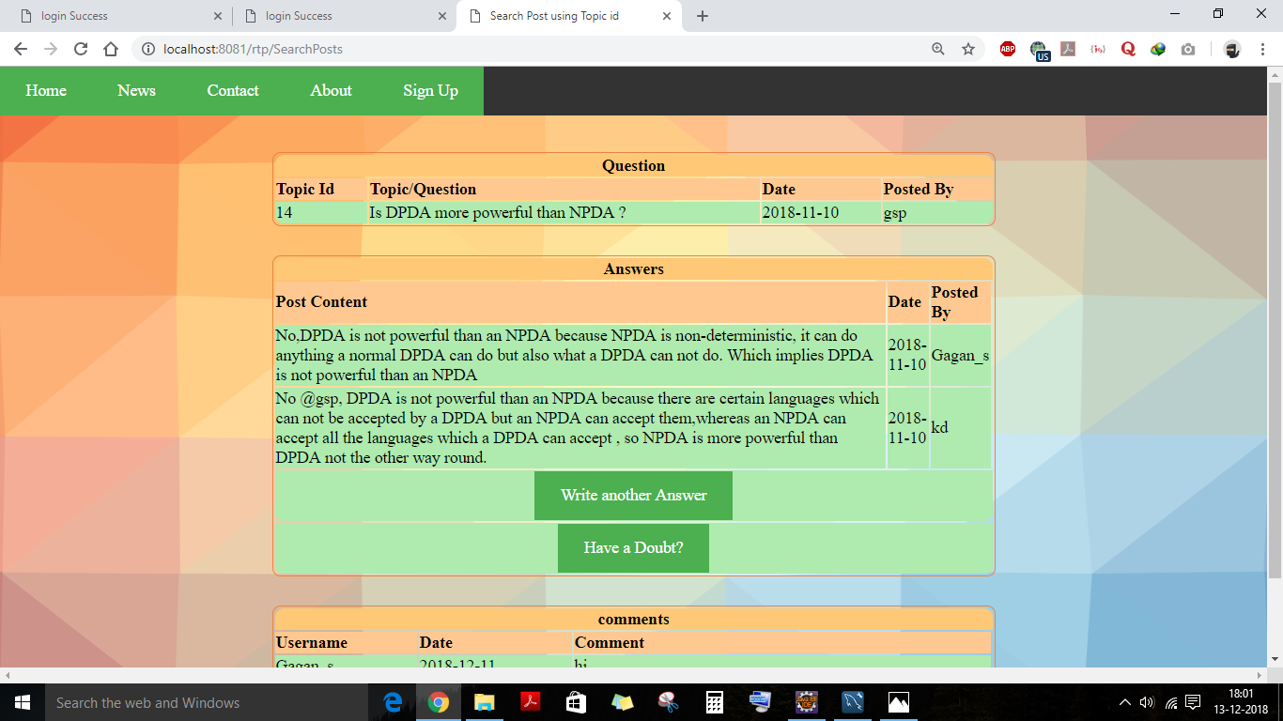

Slide 27
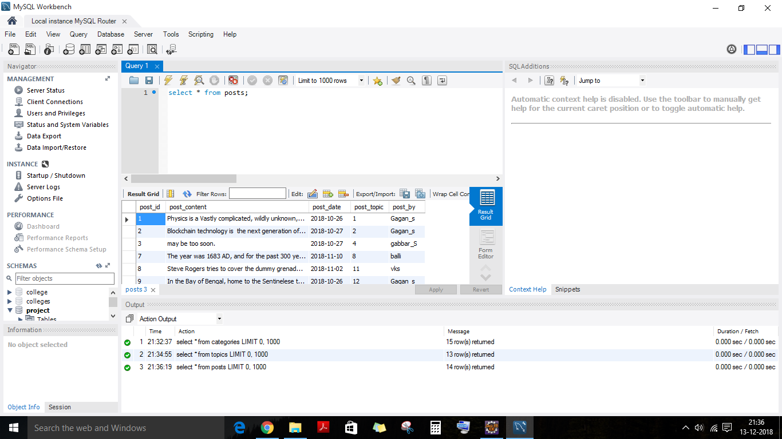

Slide 28
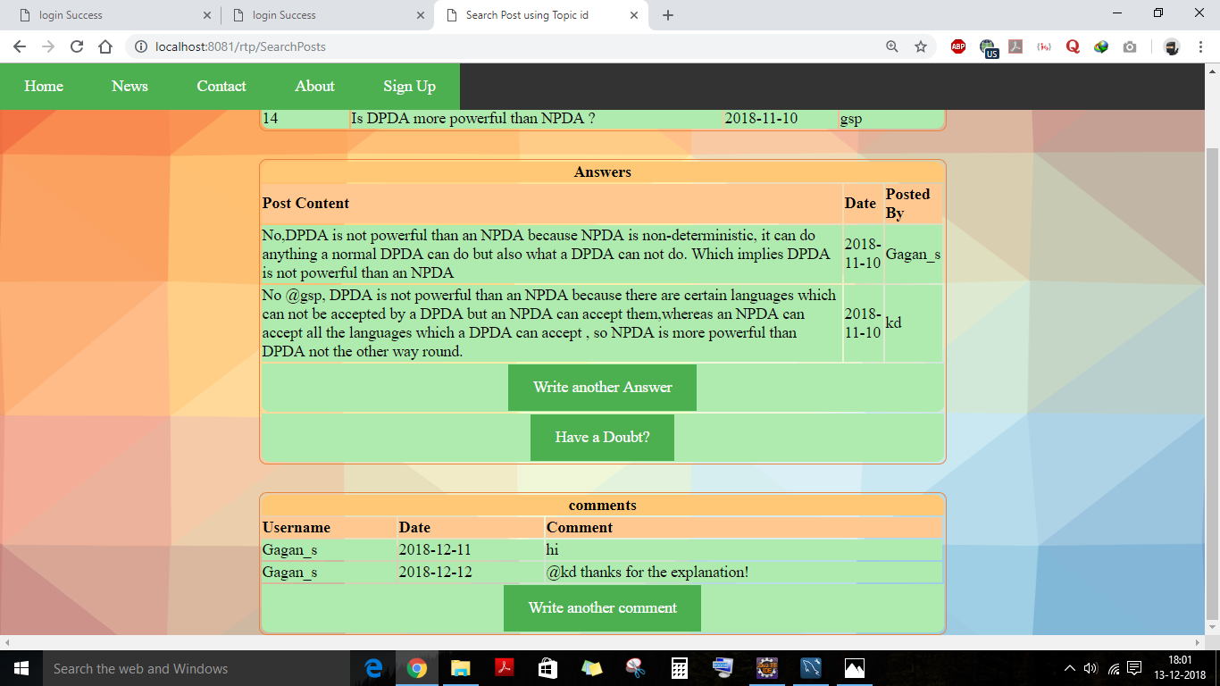

Slide 29
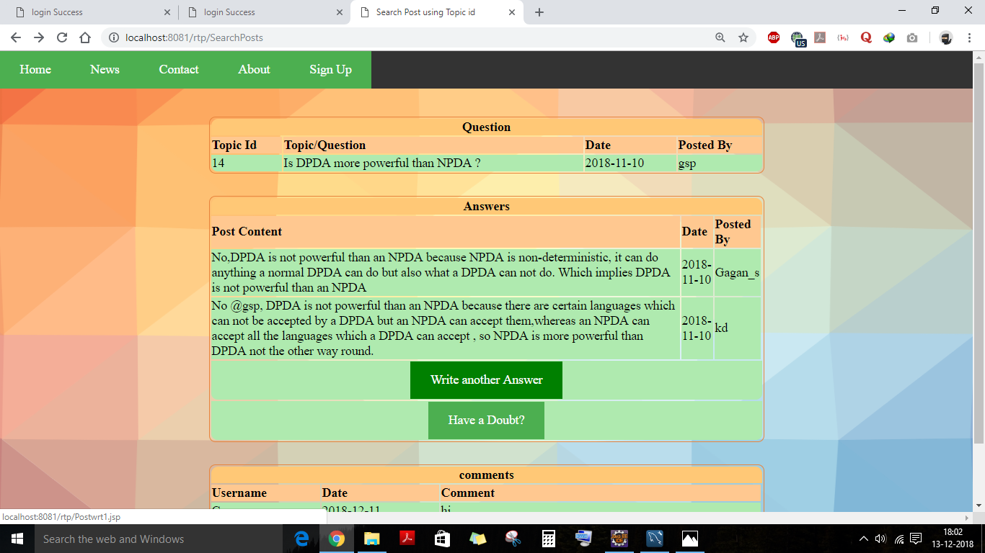

Slide 30
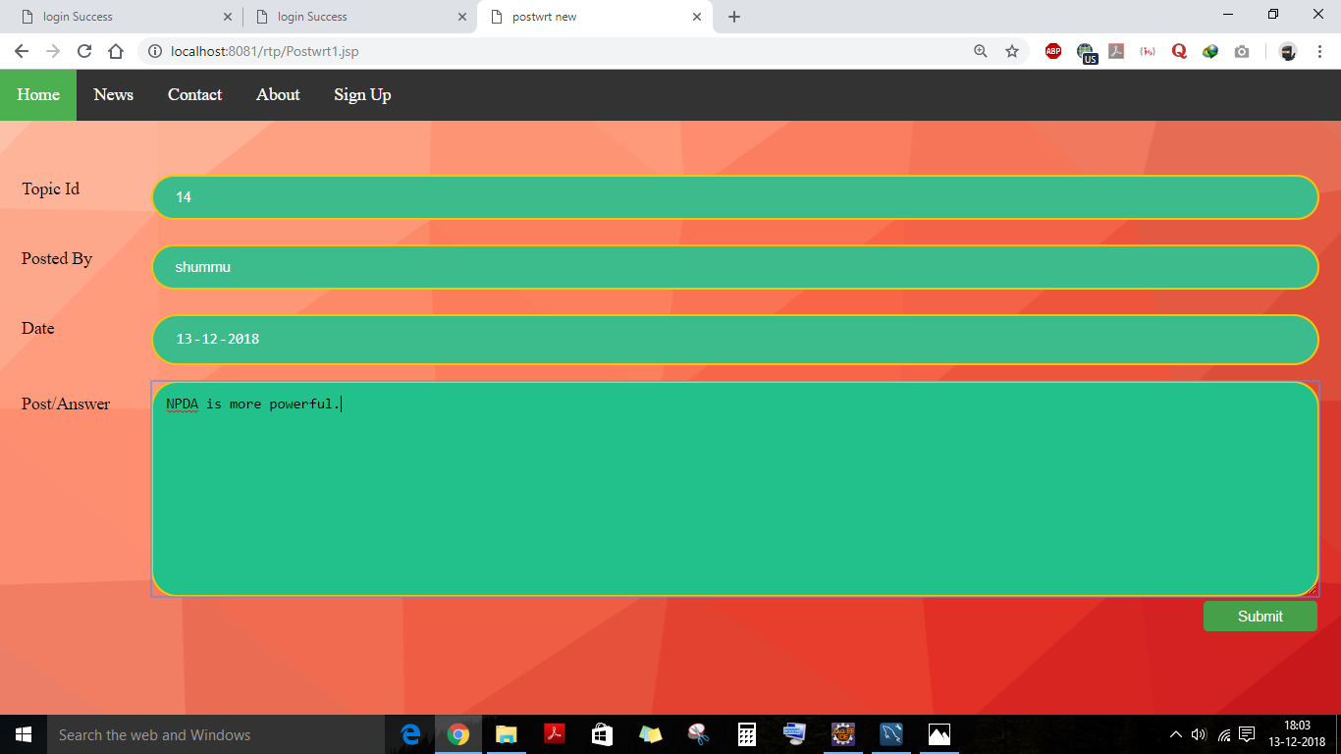

Slide 31
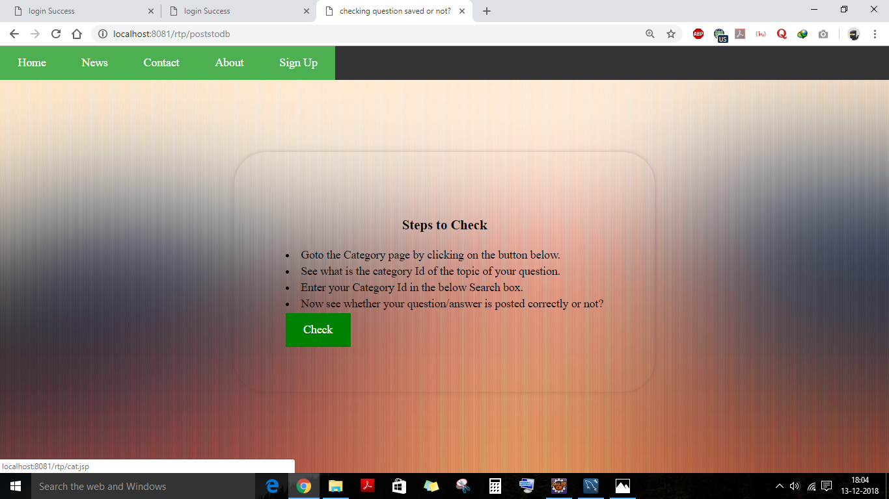

Slide 32
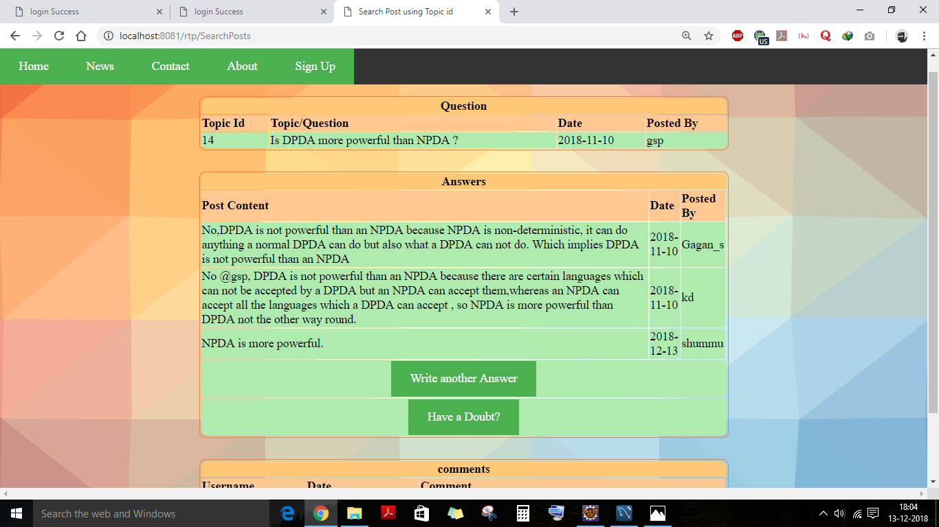

Slide 33
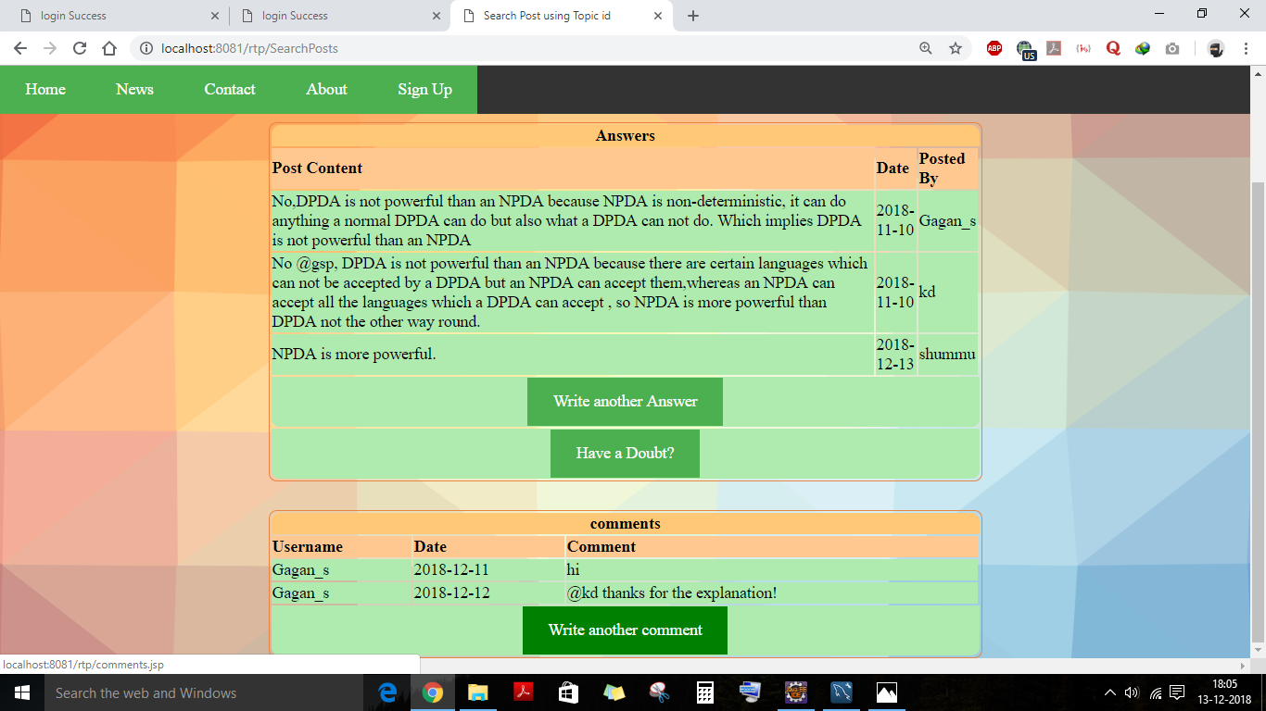

Slide 34
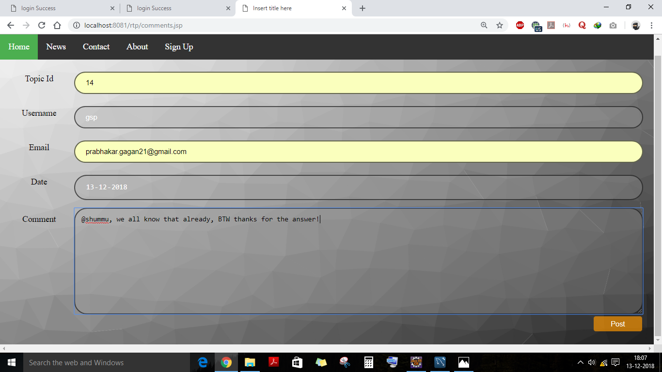

Slide 35
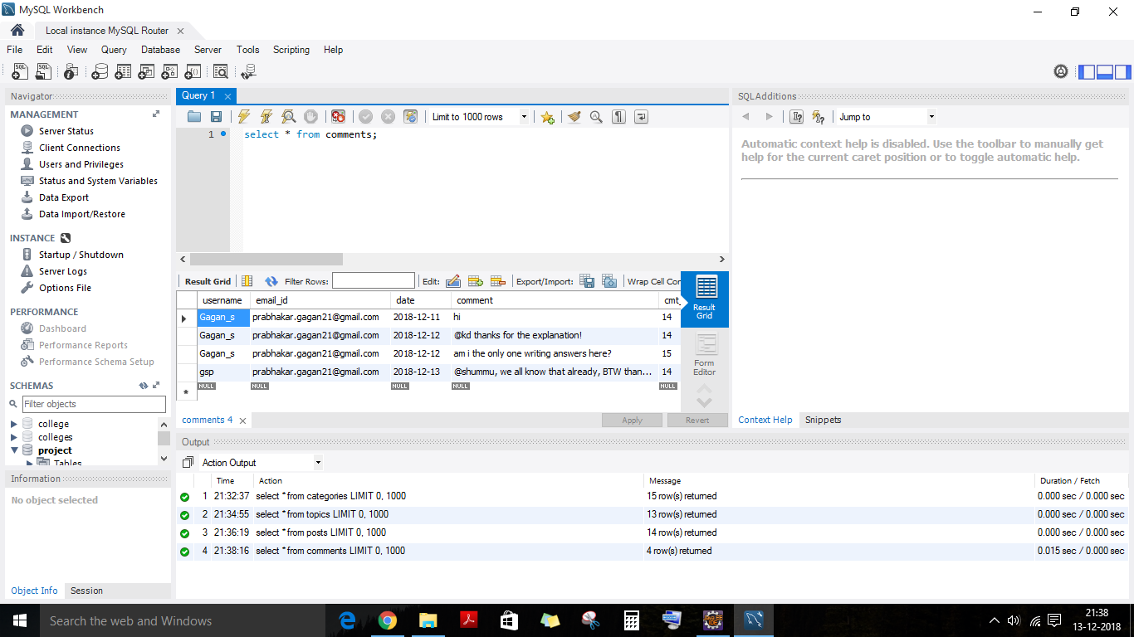

Slide 36
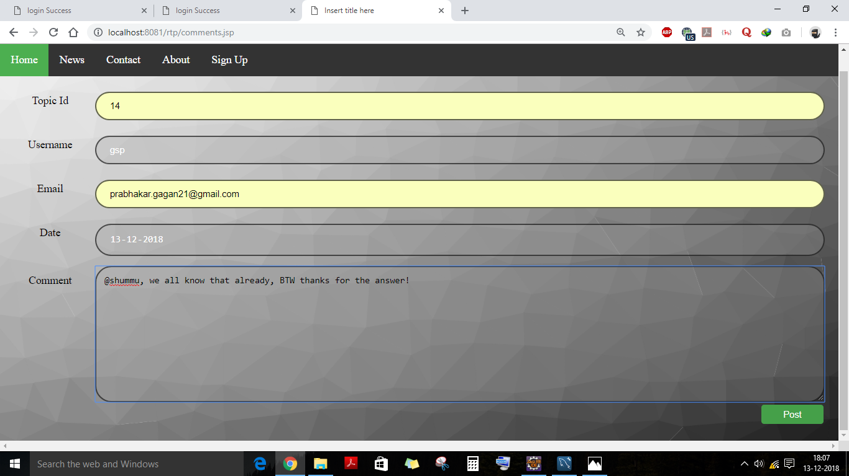

Slide 37
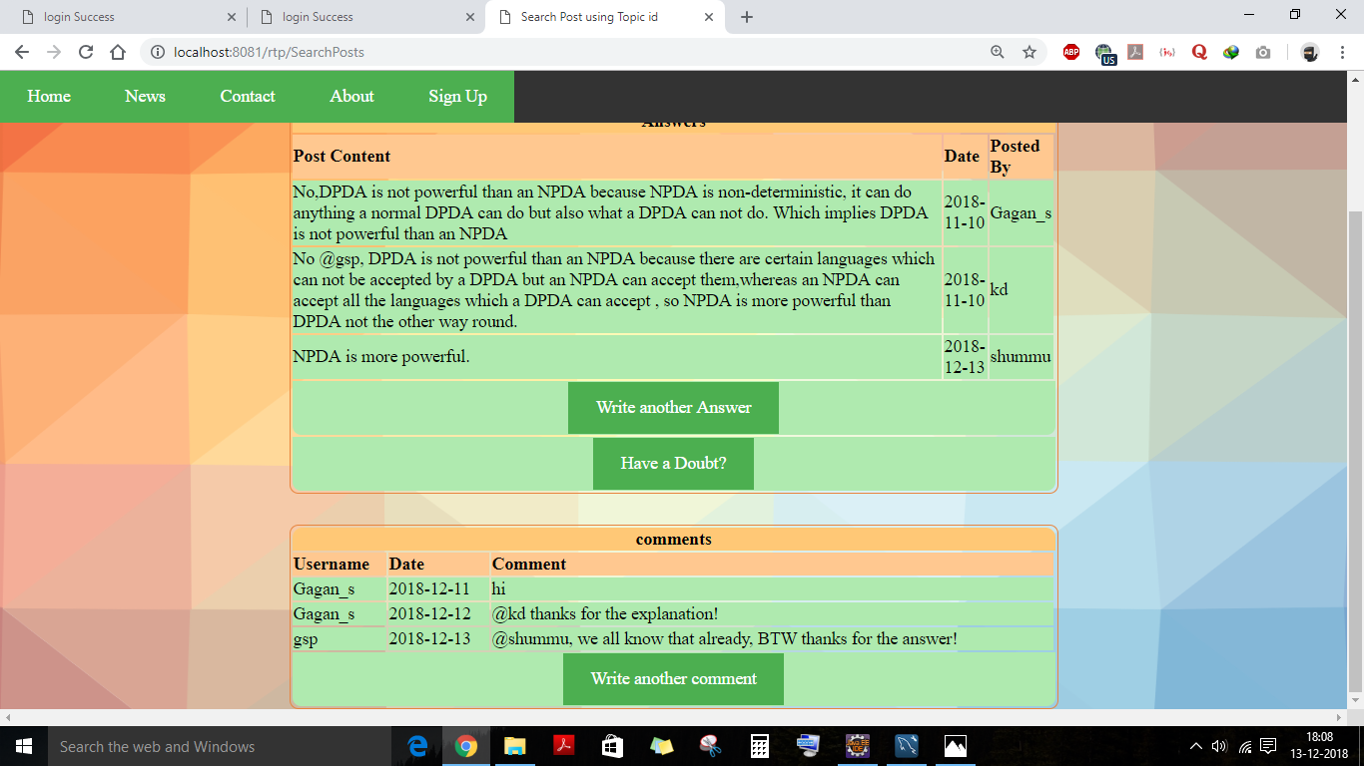

Slide 38
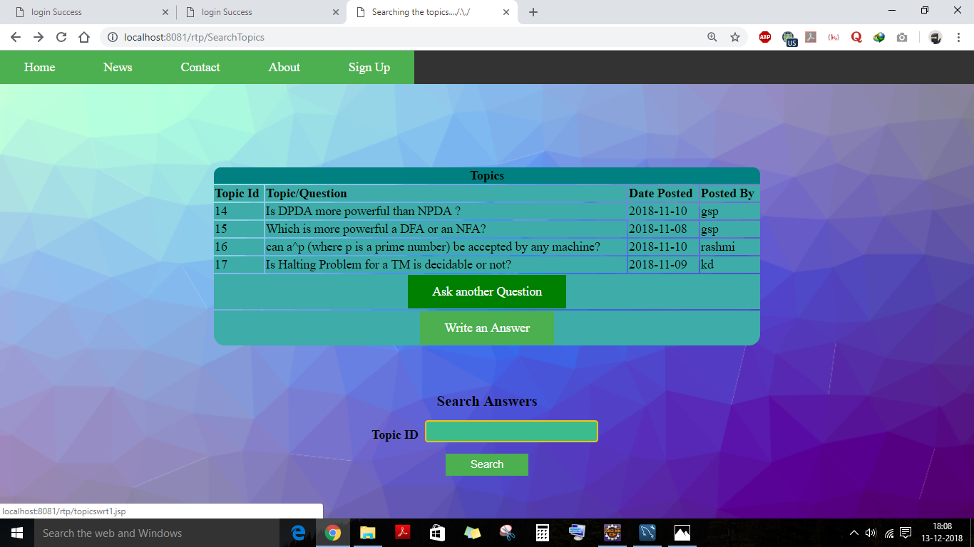

Slide 39
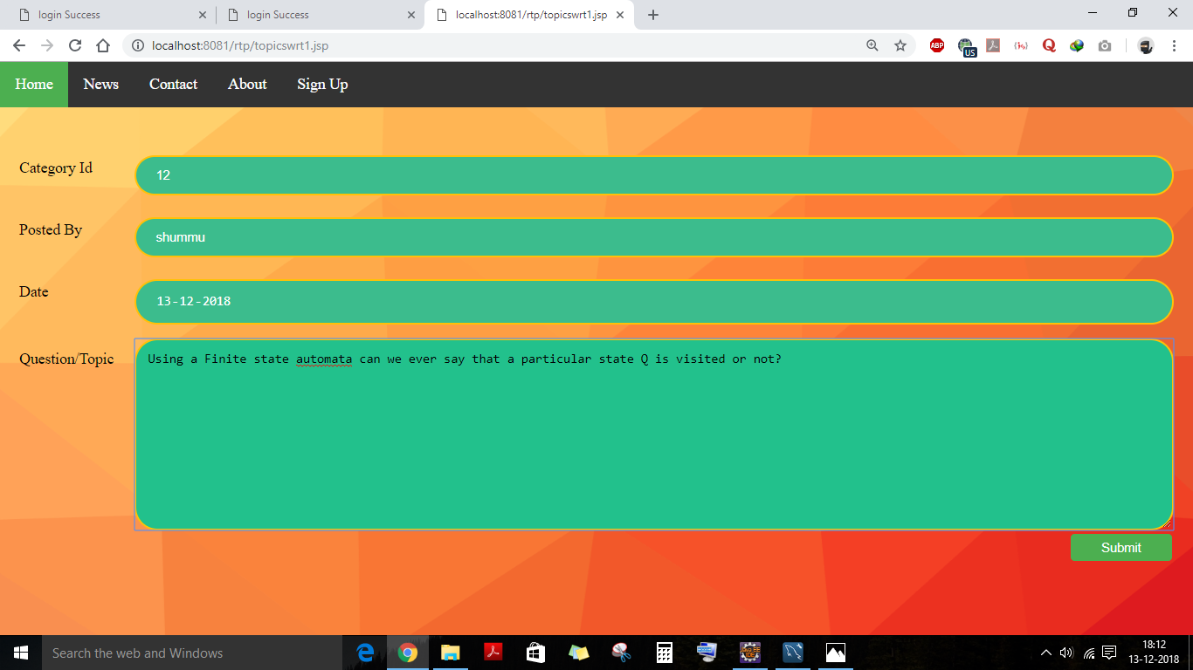

Slide 40
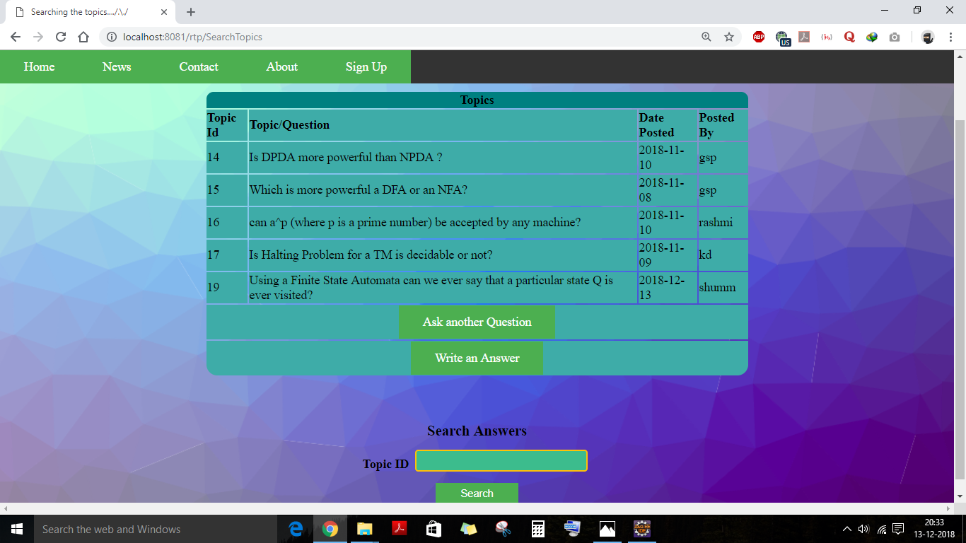

Slide 41
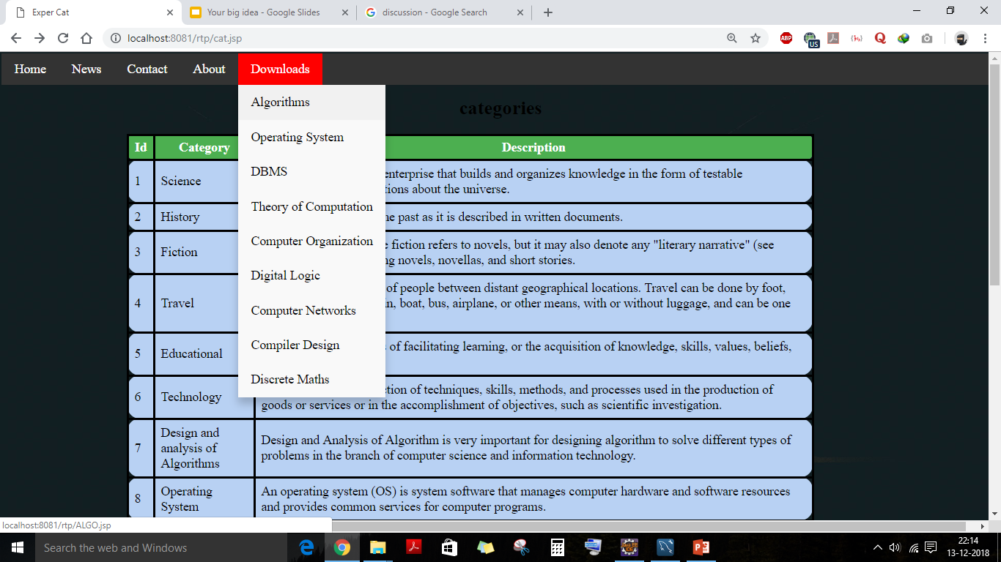

Slide 42
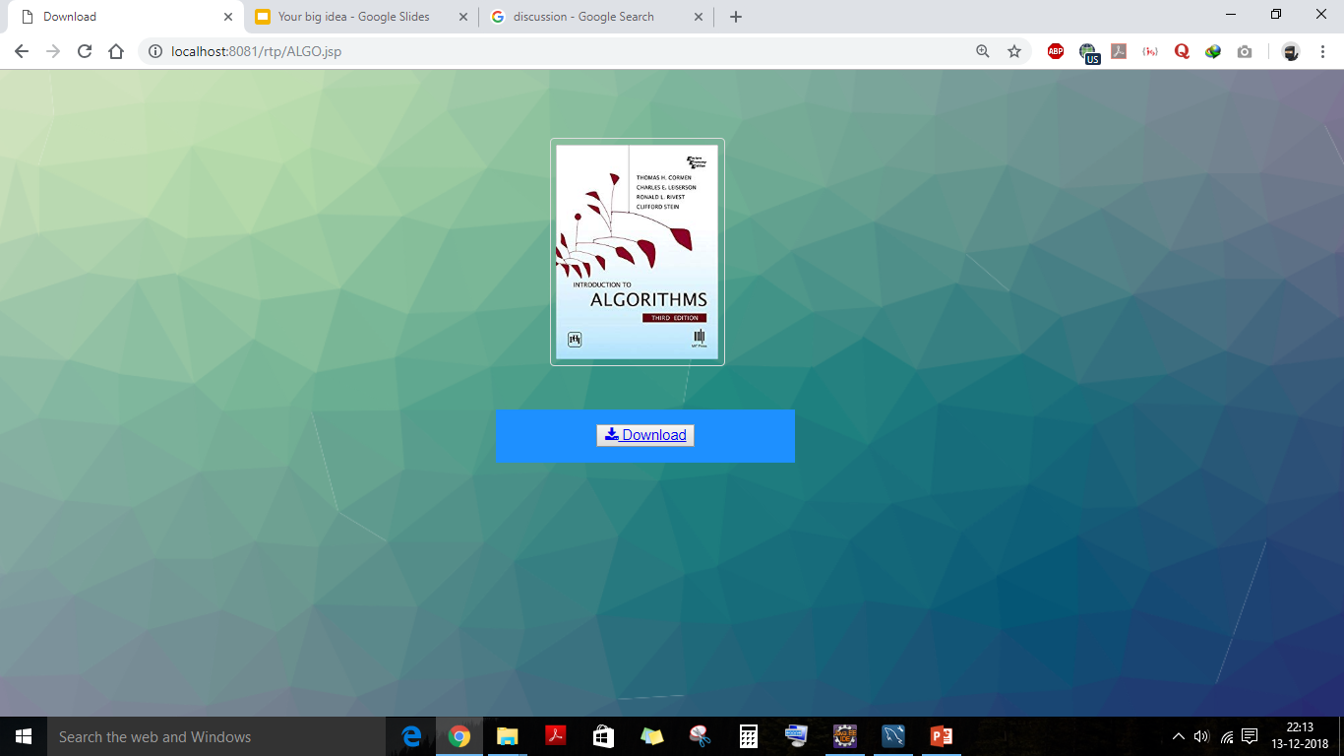

Slide 43
THANK YOU!

